Slide 1



MyRetro.com
Its your study buddy
This Photo by Unknown Author is licensed under CC BY-SA-NC

Slide 2
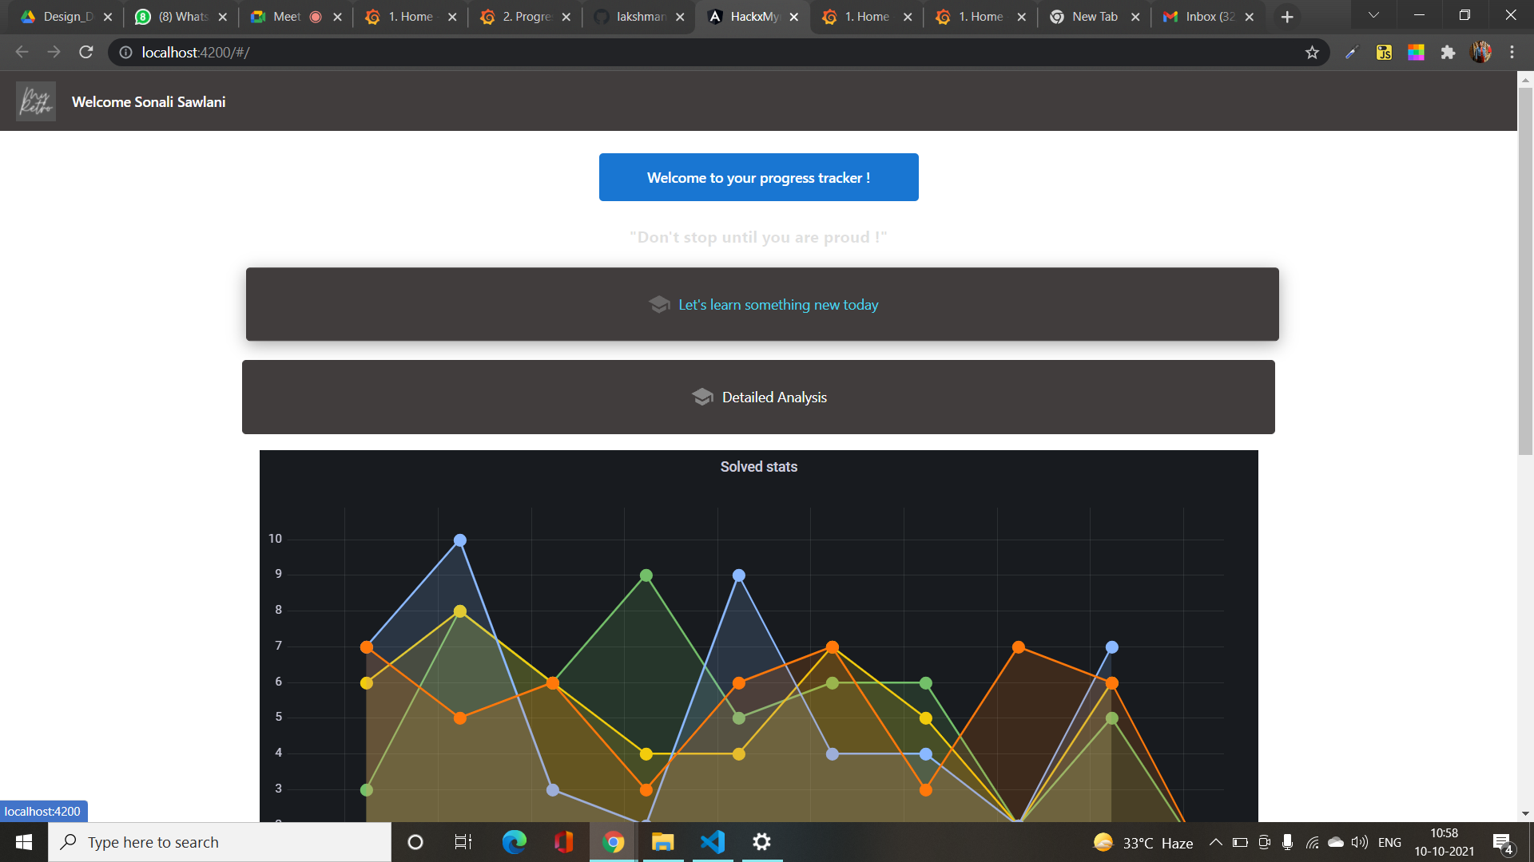
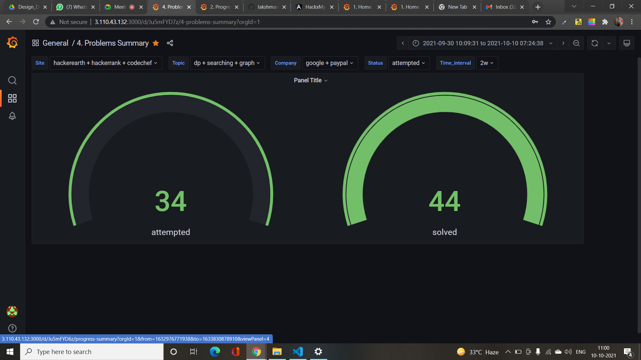

Major features built in myretro.com are listed below
These features are built having students in our mind. We wanted to make their study path easier and to have a clear perspective on their dream.
Bot Interviewer
Program Solving Capability Analysis
Community Interactions
Personal Challenges

Slide 3
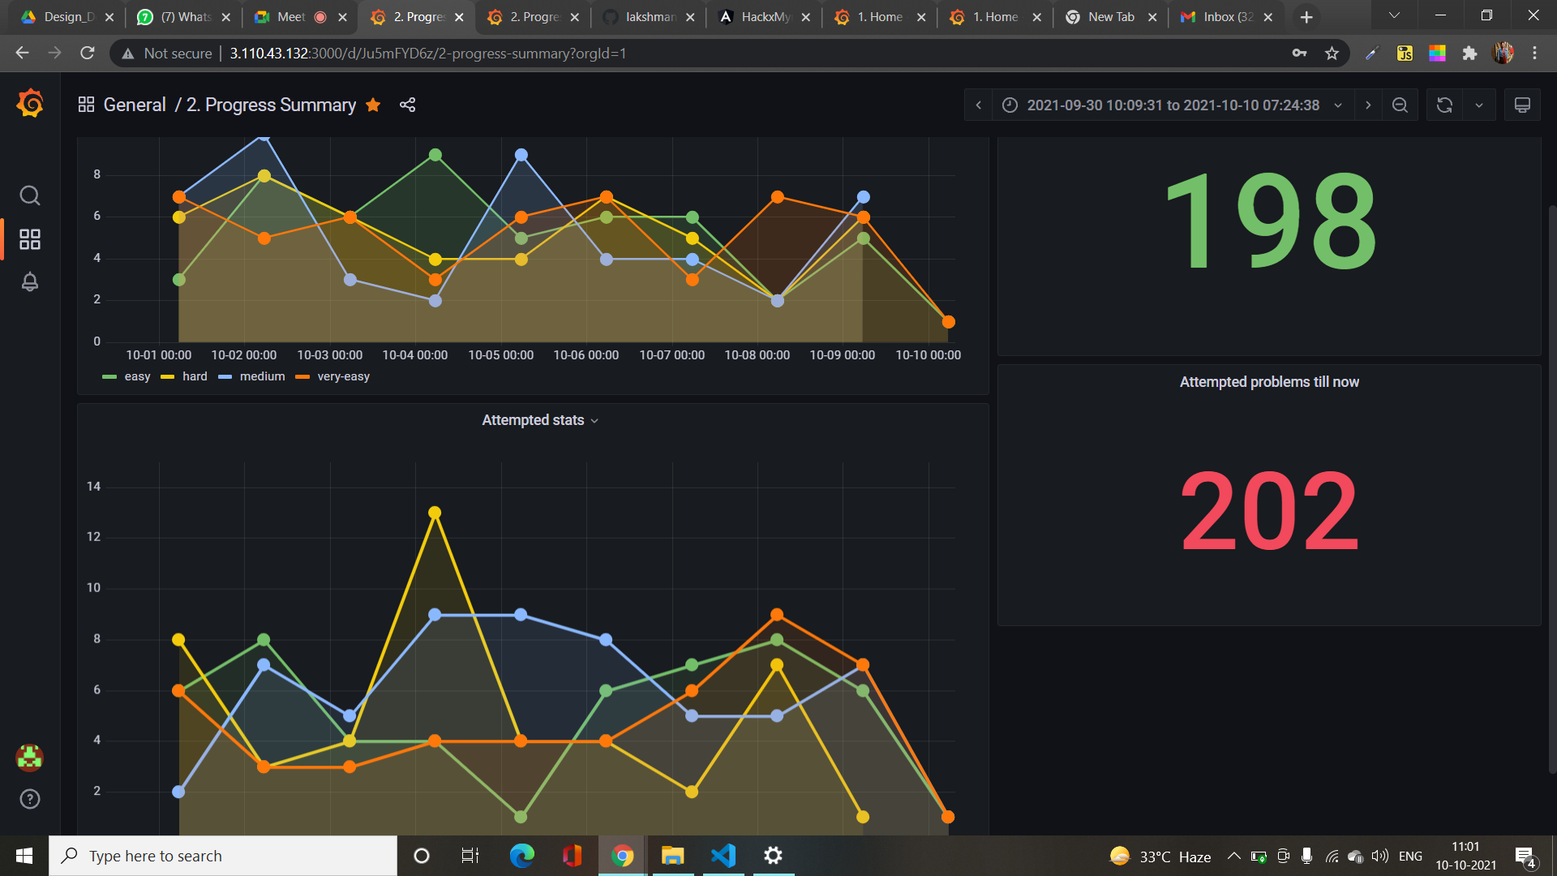
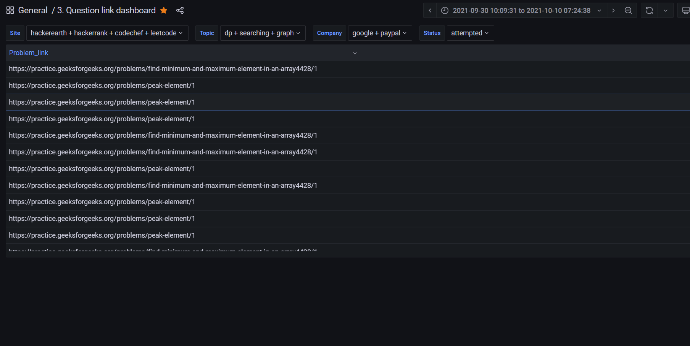

Bot interviewer: With the bot interviewer user can get the mock interviews anytime and anywhere. With wide range of topics and AI/ML integrated one can use bot interviewer to upscale themselves. Problem Solving Capability Analysis: Students will get a collective information on their skillset as a graph/percentage points from different platforms they learn. With our neat algorithm it showcase the areas they strong at and areas need improvement. Allocation of badges based on their involvement towards learning and motivational quotes, learn a new thing daily and daily commitment setting are some other features included.

Slide 4


Community Interactions: In community interactions user get to share their daily commitments, strength and area of improvements, thought process through dashboard general container for teaching something, Sharing interview experiences. Personal Challenges: Personally user can challenge themselves by setting daily goals. Solving more problems, taking more interviews, attending competitions can help improving the skillset.

Slide 5


Thank You
Team: Keys.
Team mantra: we are the keys to future.
Contributors: Lakshmana prasanth, akanksha deep, pratik das baghel and sonali sawlani.

